Slide 1

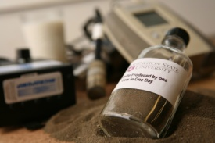




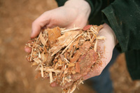

Influence of Fall Dormancy on Alfalfa Quality
Steve Norberg, WSU; Cesar Culma, UMN;
Zhanyou Xu, ARS, Don Llewellyn, WSU, Long-Xi Yu, ARS;
Guojie Wang, Penn State U; Steve Fransen, WSU;
David Combs, UW; Glenn Shewmaker, UI; Sen Lin, WSU
YOUTH & FAMILIES
AGRICULTURE
YOUTH & FAMILIES
HEALTH
ECONOMY
ENVIRONMENT
ENERGY
COMMUNITIES
AGRICULTURE
HEALTH
ECONOMY
ENVIRONMENT
ENERGY
COMMUNITIES

Slide 2

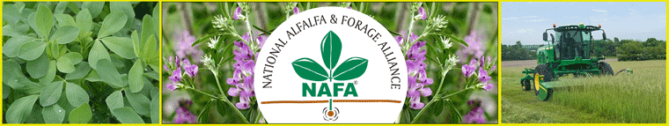
This research was funded by:

Slide 3
Objectives
1) Determine quality of Fall Dormancy Standard varieties at three locations in the PNW
2) Determine the impact of fall dormancy on forage quality
3) Extend the knowledge gained

Slide 4
Methods
Traditional ANOVA analysis was done to determine interactions.
Because there is so much variation caused by environments and cutting I transformed the data using vernal as 100% and other varieties were relative to vernal.
After regression analysis back transformation from the regression results was accomplished.

Slide 5
Varieties in this analysis
Standard Fall Dormancy Score | Variety Name
1 | Maverick
2 | Vernal
3 | 5246
4 | Legend
5 | Archer
6 | ABI700

Slide 6
Start 2019 and 2020 ANOVA Analysis
 | #
First | 0
Second | 3 |  |  | Fat |  |  |  |  |  | NDFD |  |  |  |  |  | Qual Adj
Third | 8 |  |  | Fat |  |  | NEL |  |  | NDFD | TDN | DMI | RFQ | Energy |  | Qual Adj
Fourth | 15 | ADF | aNDF | Fat | Lignin | WSC | NEL | RFV | NFC | NDFD | TDN | DMI | RFQ | Energy | Fiber | Qual Adj

Slide 7
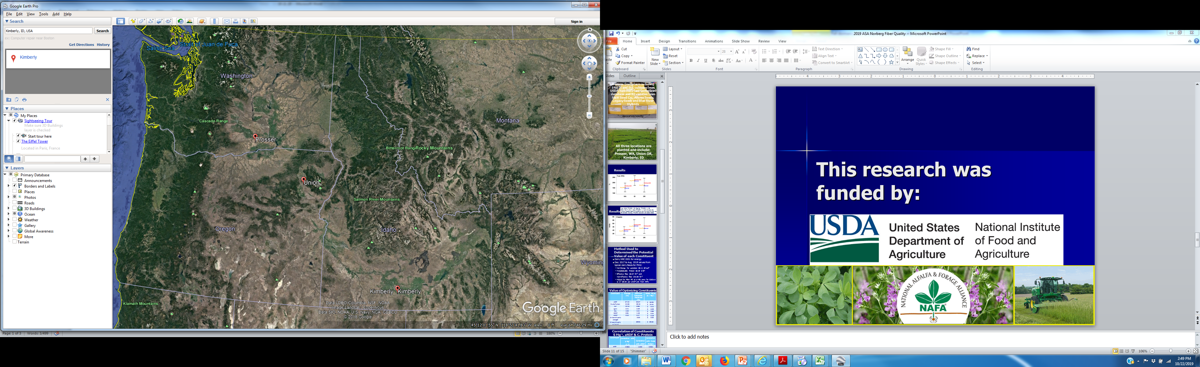
Elevation 203 m (665 ft)
Elevation 851 m (2,791 ft)
Elevation of 1,196 m; (3,924 ft.)

Slide 8
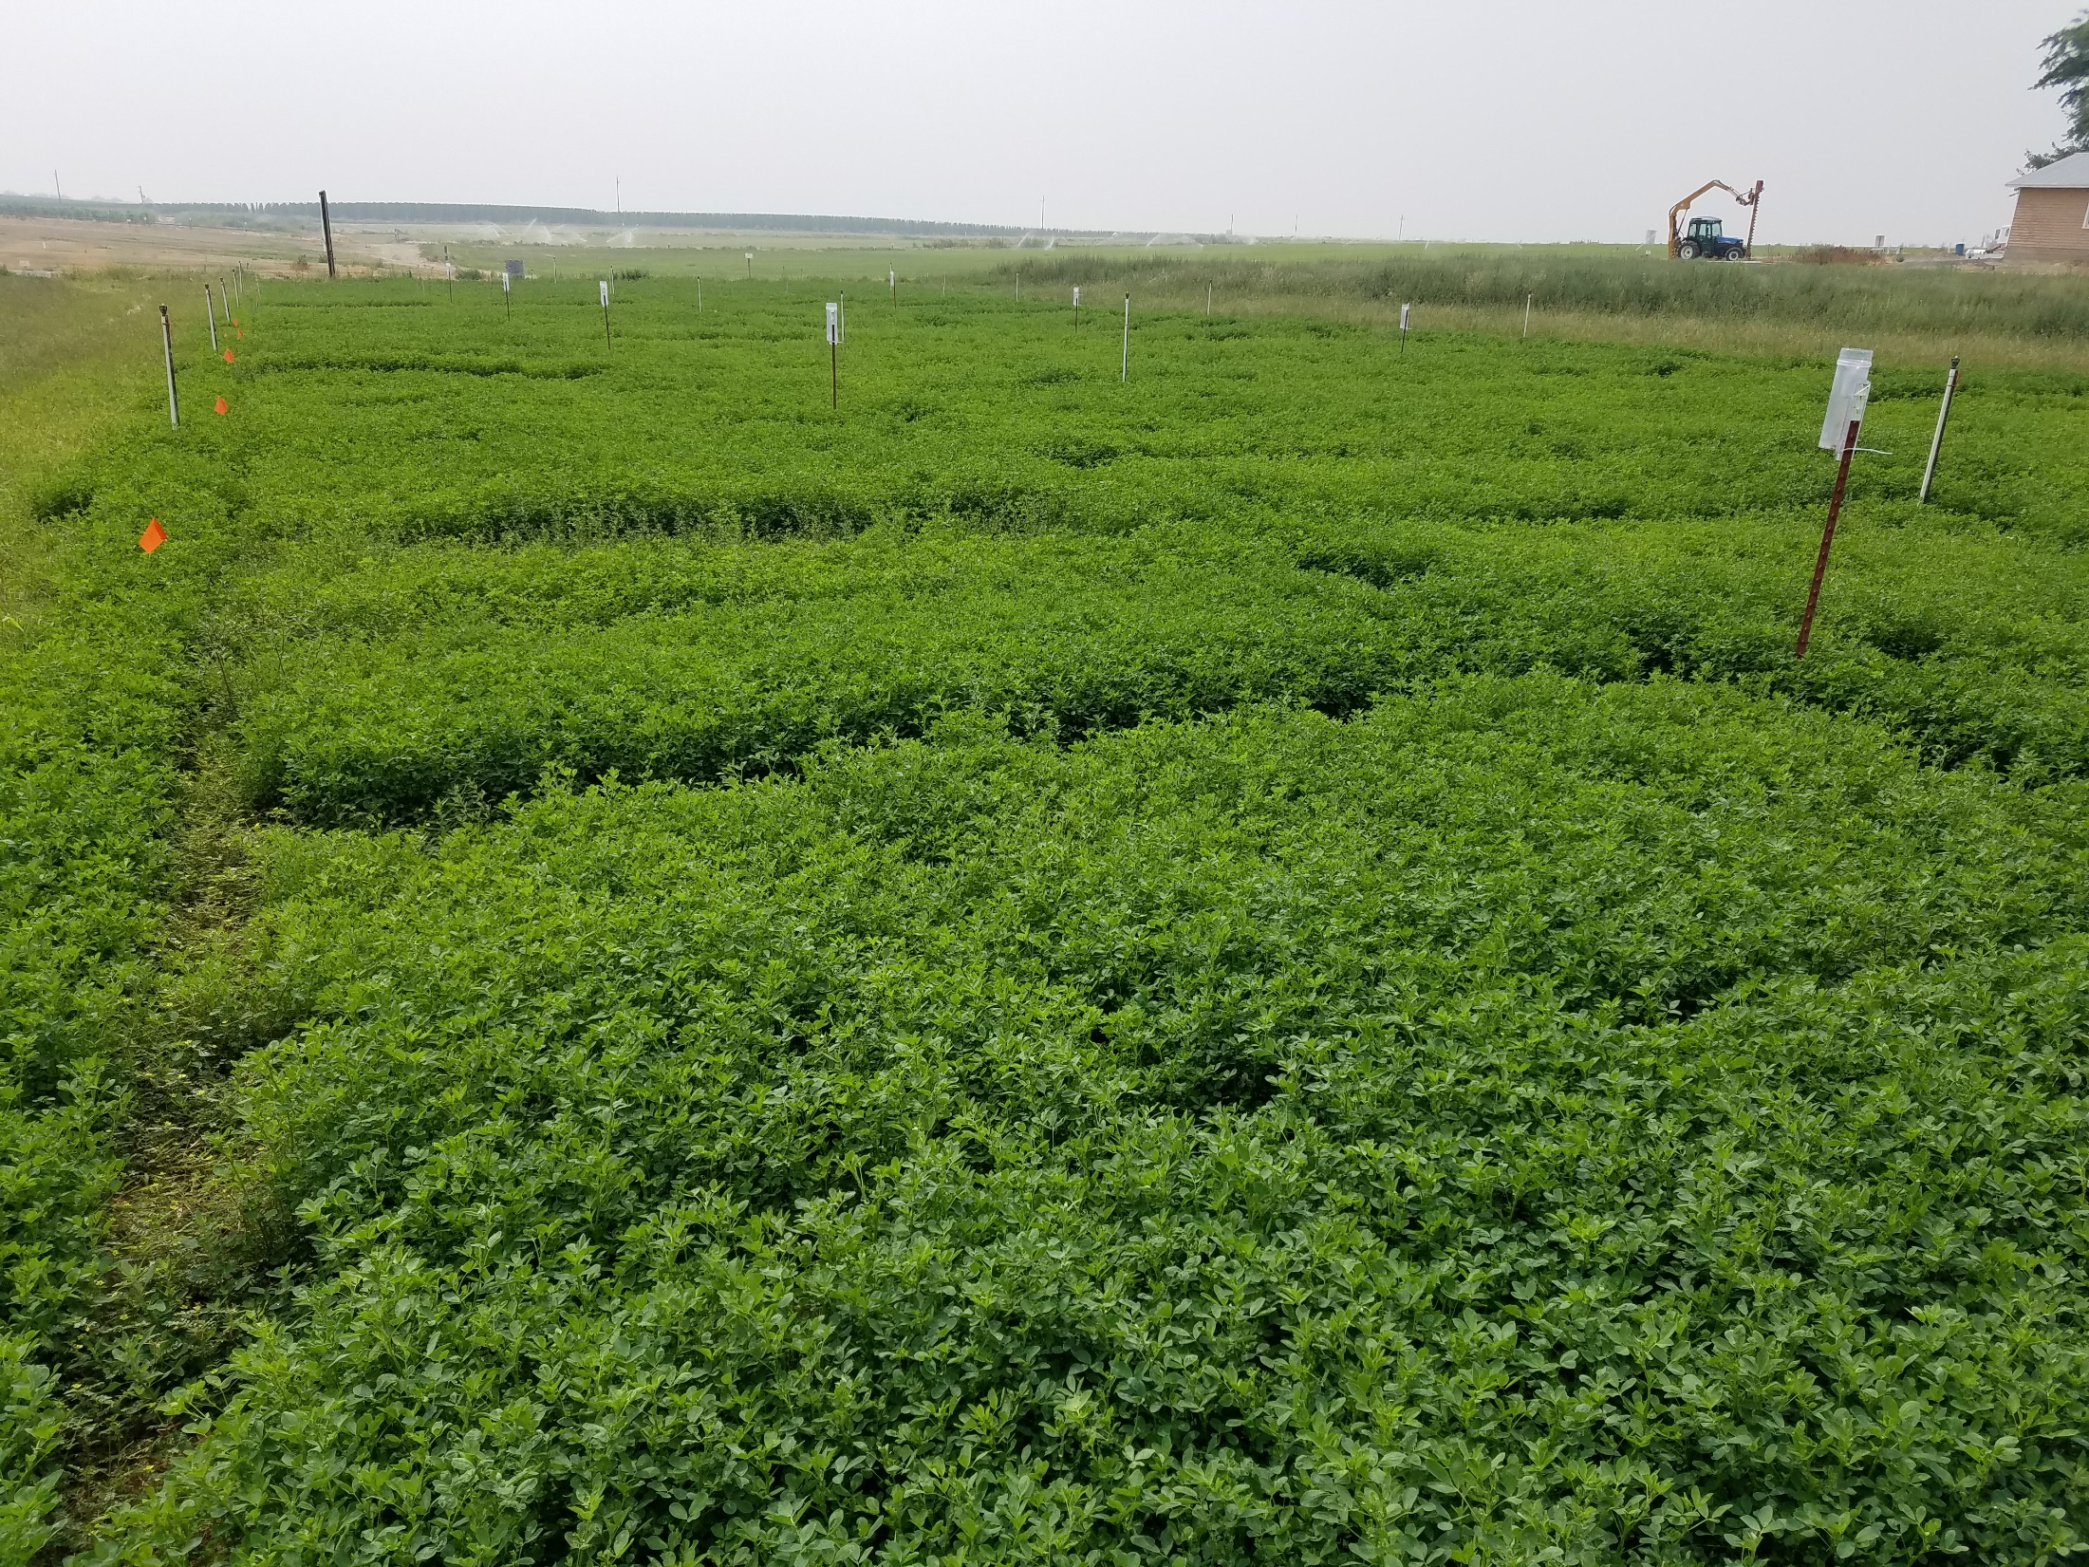
Prosser, WA
Before second cutting on 8/23/2018

Slide 9
2019-2020 Crude Protein as Influenced by Fall Dormancy

Slide 10
2019-2020 NDFD 48 hours as Influenced by Fall Dormancy

Slide 11
2019-2020 Quality Adjustment For Fiber Fill as Influenced by Fall Dormancy

Slide 12
2019-2020 Fat Concentration as Influenced by Fall Dormancy

Slide 13
2019-2020 Relative Feed Quality as Influenced by Fall Dormancy

Slide 14
2019-2020 aNDF as Influenced by Fall Dormancy

Slide 15
2019-2020 Lignin as Influenced by Fall Dormancy

Slide 16
Conclusions
Fall Dormancy rating did not affect protein
The impact of fall dormancy was greater on later cuttings and no measurable impact on first cutting
NDFD decreased linearly with increasing fall dormancy significantly on 2nd, 3rd, 4th, cuttings
Increasing fall dormancy negatively impacted quality adjustment for fiber fill in the dairy cow was impacted quadratically

Slide 17
Conclusions
Increasing fall dormancy negatively influenced fat concentration linearly especially 2nd through 4th cuttings.
RFQ, aNDF and lignin was mostly influenced by Fall Dormancy 1 positively

Slide 18
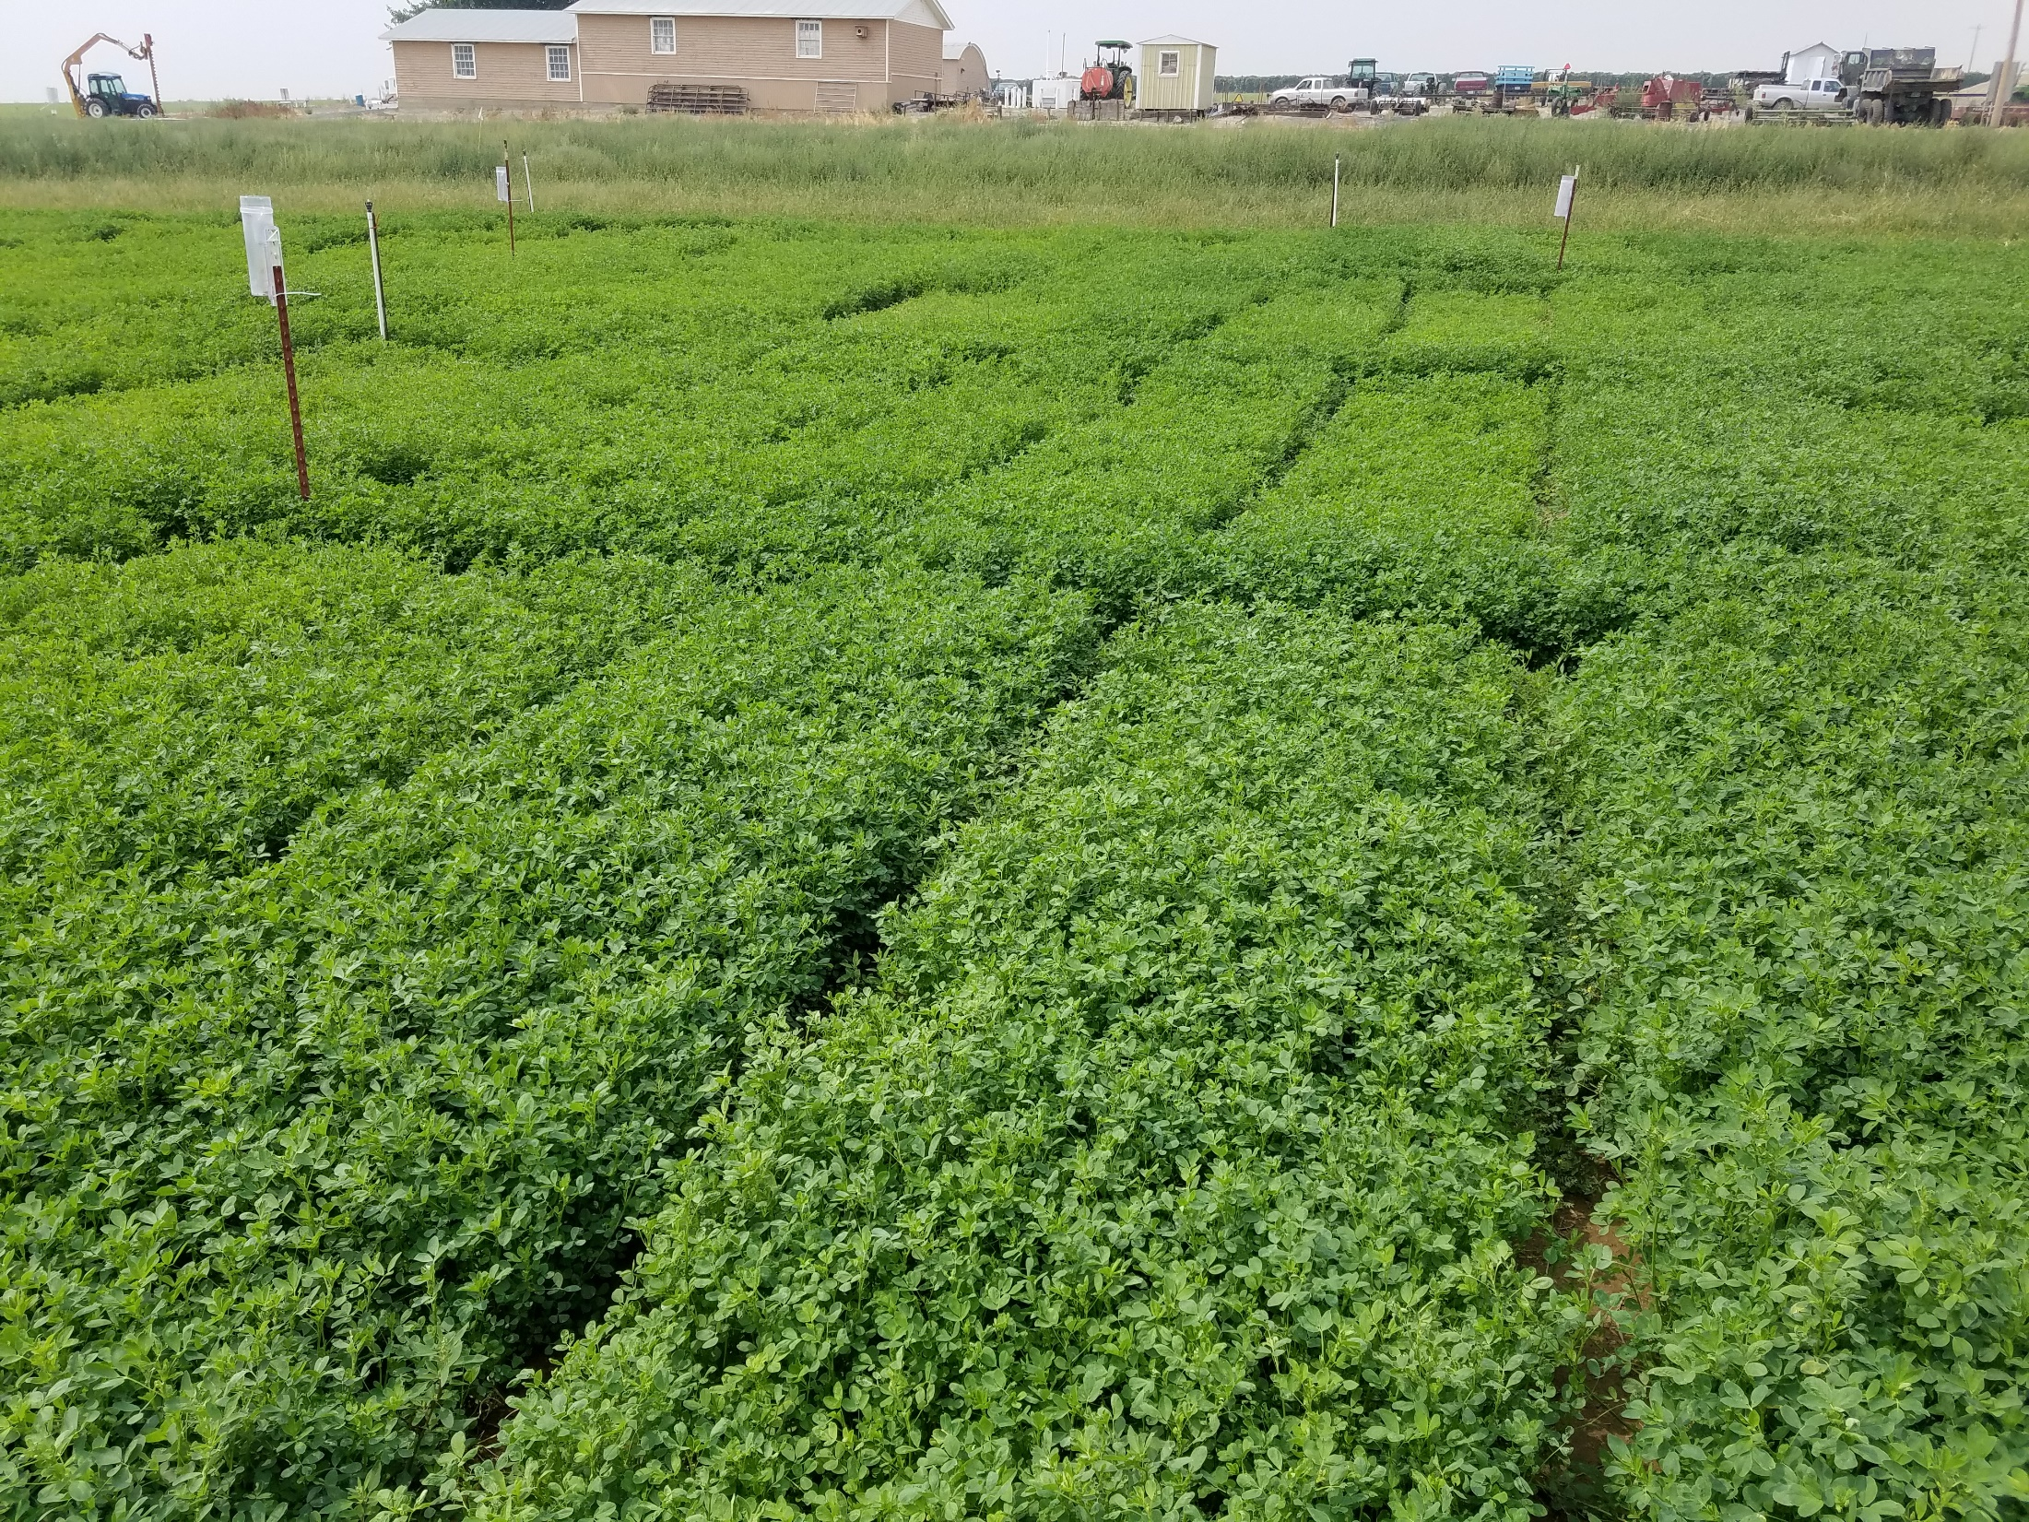
Questions?

Slide 19
2019-2020 Crude Protein as Influenced by Cutting

Slide 20
2019-2020 ADF as Influenced by Cutting

Slide 21
2019-2020 aNDF as Influenced by Cutting

Slide 22
2019-2020 Ash as Influenced by Cutting

Slide 23
2019-2020 Fat as Influenced by Cutting

Slide 24
2019-2020 Lignin as Influenced by Cutting

Slide 25
2019-2020 Lignin as Influenced by Cutting

Slide 26
2019-2020 Calcium as Influenced by Cutting

Slide 27
2019-2020 Phosphorus as Influenced by Cutting

Slide 28
2019-2020 Potassium as Influenced by Cutting

Slide 29
2019-2020 Magnesium as Influenced by Cutting

Slide 30
2019-2020 Ethanol Soluble Carbohydrates (ESC) as Influenced by Cutting

Slide 31
2019-2020 Water Soluble Carbohydrates (WSC) as Influenced by Cutting

Slide 32
2019-2020 Starch Concentration as Influenced by Cutting

Slide 33
2019-2020 Net Energy for Lactation as Influenced by Cutting

Slide 34
2019-2020 Relative Feed Value as Influenced by Cutting

